Slide 1
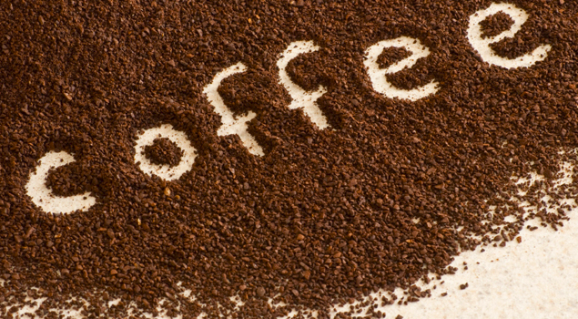
Coffee
BY: THE amazing Campbell little

Slide 2
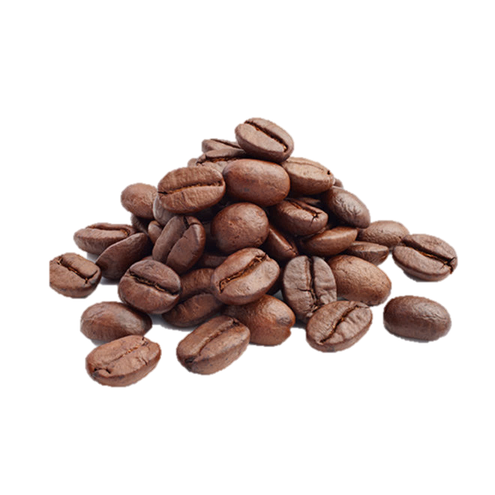
Steps of Coffee
From bean to cup

Slide 3
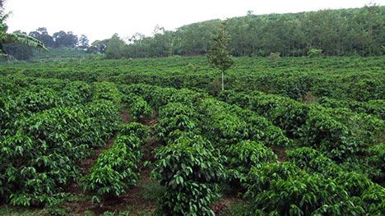
Step 1- Growing
This is how coffee is grown. Coffee trees grow in tropical/ subtropical climates. It can’t grow more than 1,000 miles from the equator. Coffee trees start their lives usually in a nursery and stay there until they’re 18-24 inches tall (usually after a year). Coffee trees can grow up to 20 feet tall but for best results grow until 8 to 10 feet tall. It takes 4-5 years for a coffee tree to start making coffee (which is way too long for me to wait for my cup of coffee!!!!!). Six to nine months later in the process, green cherries appear. This is where the coffee beans live. Depending on where you are when you plant your coffee tree, the cherries will turn a color and then turn a deep red when they are ripe.

Slide 4
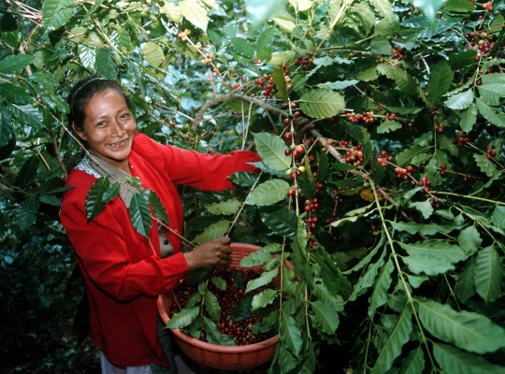
Step 2- Harvesting
Farmers and their families who harvest coffee typically harvest their coffee by hand into large sacks or bags when the cherries are ripe. In some communities, the people all share the work of harvesting the coffee. Equal Exchange coffee harvests their coffee by hand! That is a lot of work. Because coffee grows at different rates, it may take 3 to 7 pickings to get all the coffee harvested. The lower the altitude, the sooner the coffee will be ready to harvest.

Slide 5
Step 3- Depulping
Once the coffee cherries are picked, you must depulp the cherries within the next day. If you don’t depulp the cherries within the next day, then the coffee may taste bad and the fruit may rot. You can hand depulp coffee or you can do it with a machine. Many people that hand depulp the coffee share the station with their neighbors and even community. When you depulp a coffee cherry what you are doing is separating the coffee seed (bean) from the outer layer of flesh, from the cherry. Sounds gross, but that’s the truth.

Slide 6
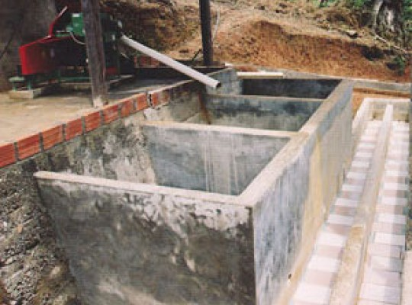
Step 4- Fermenting
Incite or stir up
Fermentation is the process of accentuating the body and flavor of the coffee beans. To begin the process, the depulped coffee beans are placed into a giant clean tank made of cement. The beans ferment in the mucilage that is left on the coffee bean after the depulping process transforms the natural sugars to liquid. The fermentation process can take a short time or a long time. It just depends on the weather in the room and the place. It is super important that the tank is clean when you use it or bad bacteria will show up.

Slide 7
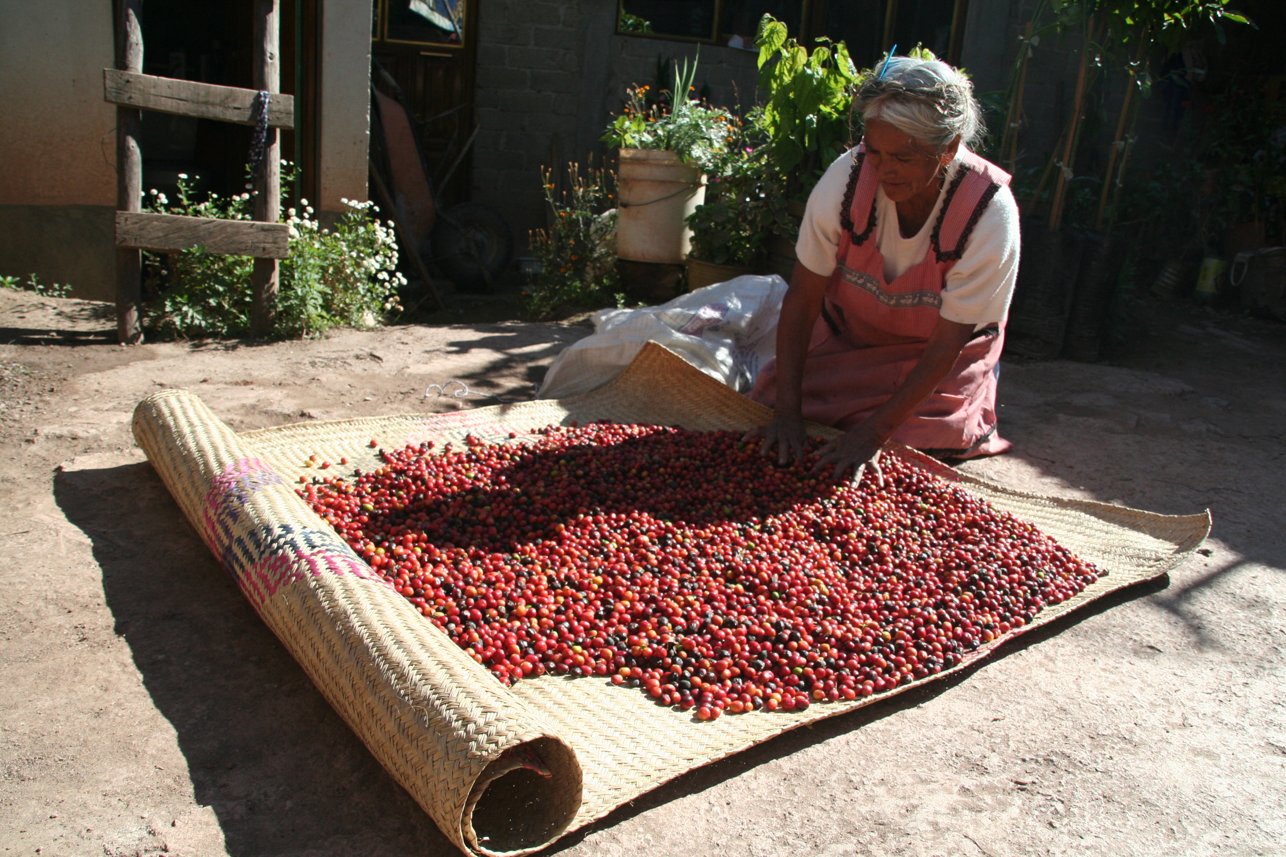
Step 5- Drying
Lots of specialty coffees are washed once the fermentation process is finished to stop the fermentation process. This is called the wet processing, where the coffee beans are washed thoroughly with clean water. This process confirms that the fermentation process is stopped. This is a very important step in the process. How long the process takes depends on the weather and climate. It is so important that the beans are turned many times each day. When the coffee has been dried to 12% moisture, they are finished.

Slide 8
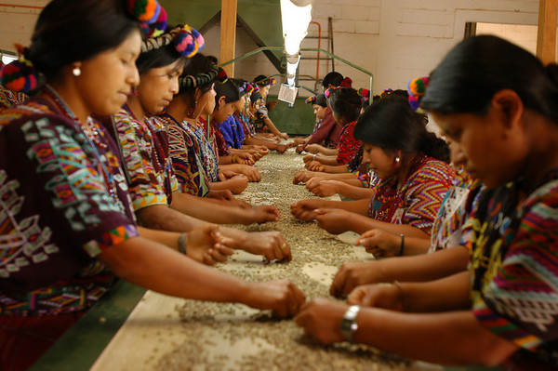
Step 6- Sorting
There are three ways the coffee beans can be sorted:
Coffee is sorted at tables by hand removing all of the defects.
A conveyer belt slowly moves coffee down through a long line of people and they pick out the bad coffee beans and the good ones stay.
With a machine it sorts the beans by color and it blows a puff of air to the beans that are discolored.

Slide 9
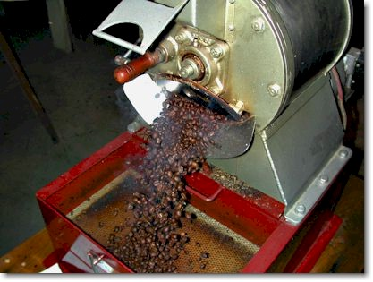
Step 7- Roasting
Roasting requires a skill set between art and science. Roasters need to have a strong attention to what’s going on, excellent memory, and a love of all things coffee. The goal in roasting coffee is to enhance the wonderful qualities of green coffee beans and develop them to their full potential! There are so many different types of roast and flavored coffee based on the roast. At Equal Exchange, each batch of roasted coffee is tested with an Agtron roast analyzer to scientifically determine the classification of the roast.

Slide 10
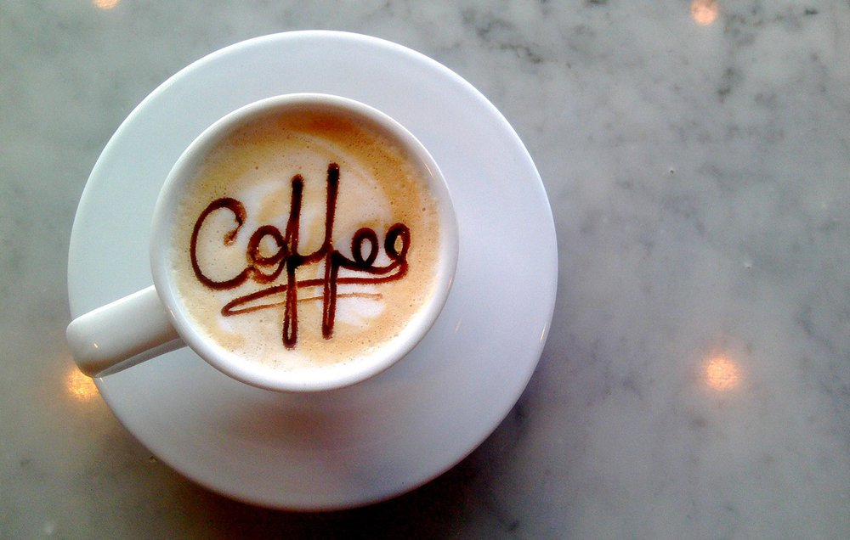
Resources
Google Images
Equal Exchange.com
Note: this is how equal exchange does their coffee not in general

Slide 11
What can I do with my research you ask?
I can start my own coffee business when I grow up and I can say, “oh ya I made that coffee!”

