Slide 1
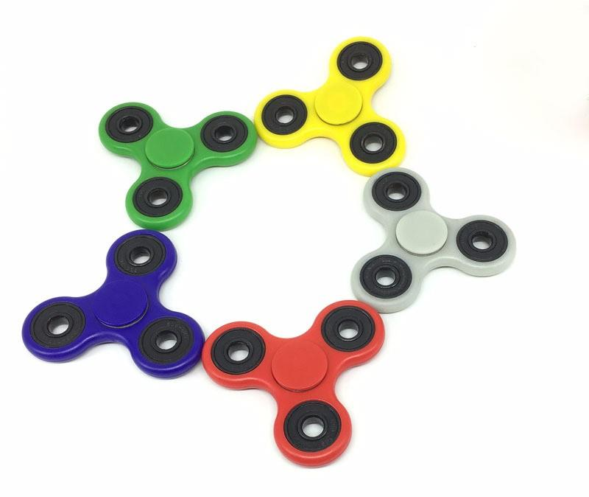
Featuring Slime!
The
Science
Behind
Fidgeting
By Sarah Cobb

Slide 2
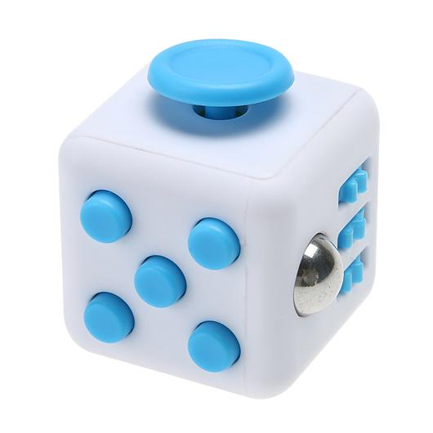
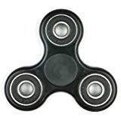
stress less!
Stress Balls & Desk Toys have been around forever, but now there are fidget spinners… and even fidget cubes! Fidget toys help relieve stress and even excess energy. Fidgeting is a response to anxiety and boredom, so fidget spinners and cubes can help with that, too! Hmmm… let’s dig deeper….

Slide 3
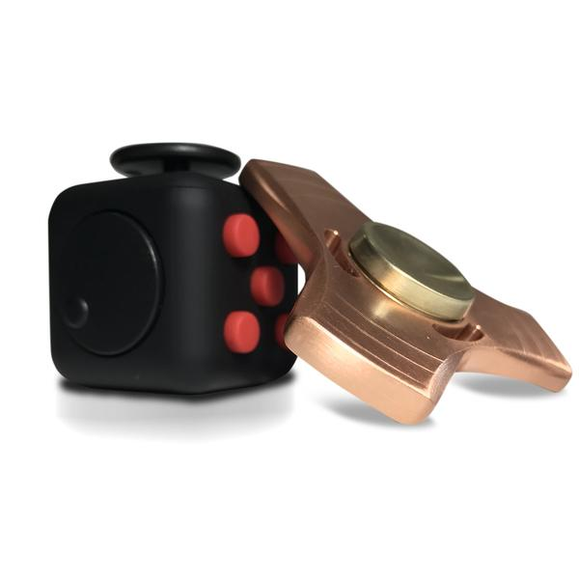
FIDGET SPINNERS
Keeps fingers busy
FIDGET CUBES
Obviously, spins:)
Releases excess energy
from $2 toMore expensive option (prices range from $2 to $240!!!!)
Cheaper option
Calms nerves
Smaller
Larger, but flat
Responds to anxiety
and boredom!
First fidget toy; it came before the fidget spinner
Came out after the fidget cube
Gives your fingers some-thing to do!
One fidgeting option! (spinning!)
More fidgeting options, buttons, dials, ect.!

Slide 4
Did you know that fidget spinners can start conversations? Studies show that a person fidgeting or has a fidget spinner that they are playing with have a higher chance of communication with others, which helps cope with depression and leads to an improved mood! “People tend to wonder what in the world you’re playing with,” Says James Plafke, a writer and professional technology expert. And listen to this, Ms. Pauli! One 2005 study concluded that kids who are allowed to fidget in class learn more quickly than those who are not. Also, “Kids who are able to move their hands in class were more able to get the answer correct.” States Karen Pine, a professor of pyschology at the University of Hertfordshire. “Don’t Stop Fidgeting!!” She says! Another fun fact; the same brain areas that are involved with fidgeting are involved with movement and speech. It seems like fidgeting may be the cure for EVERYTHING!
Don’t
STOP
Fidgeting!!

Slide 5
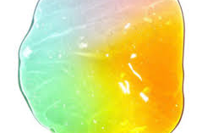
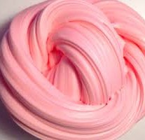
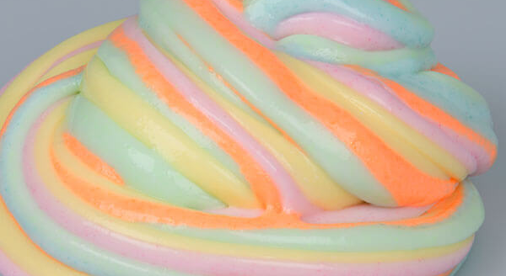
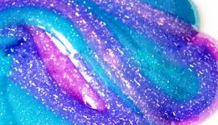
BIG QUESTION… does slime play a part in this too??
YESSS!!!
Slime and fidget spinners are the newest thing right now. But have you noticed that that they have something in common? Fidgeting! Slime satisfies- from the texture and colors to the sounds and smells. Slime is also proven to de-stress people! Slimes can be tiny, huge, squishy, fluffy, stiff, scented, and I could go on and on! All of these traits play a part in improving moods and stopping anxiety. “Of all the teens and tweens interviewed, they all agreed that slime is the key to anti-stress.” Says satisfyingslime.com. Doesn’t that sound familiar?? :)

Slide 6
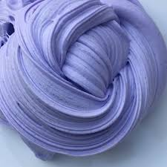
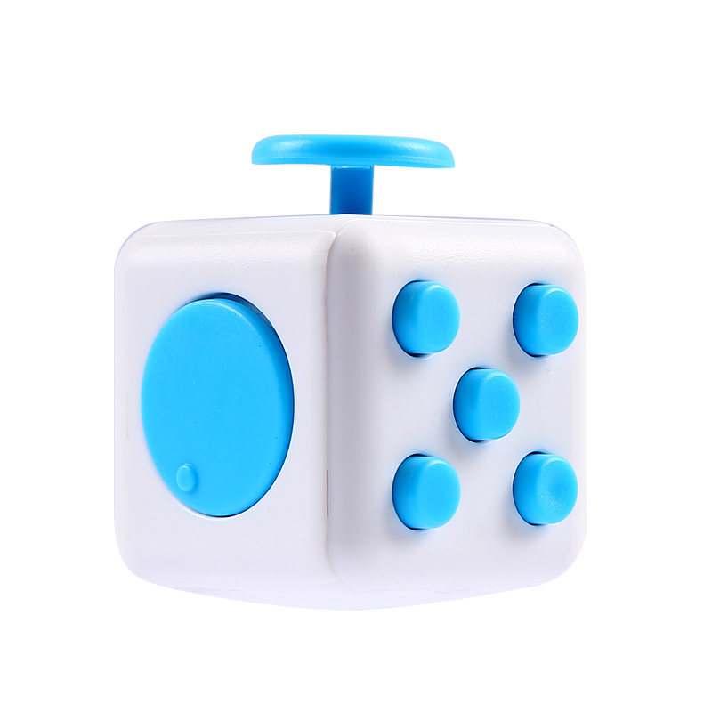
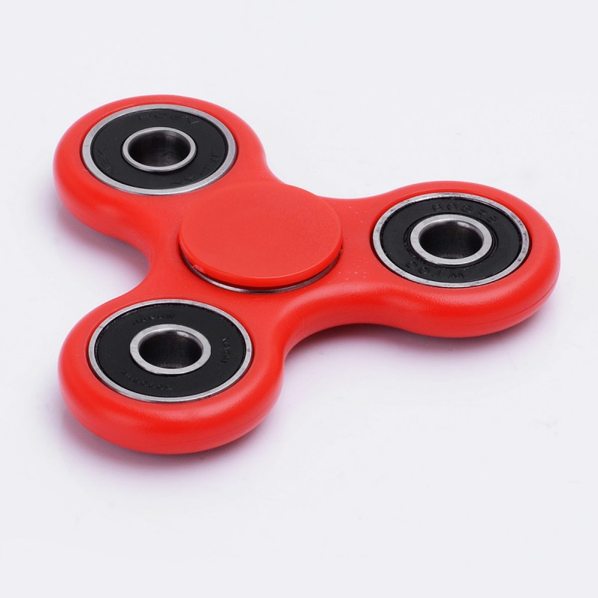
What’s YOUR opinion?
I have a fidget cube and I love it! It’s super fun and calming to play with. I love the little sounds it makes.
–Margaret☺
I have a fidget spinner and it is so soothing. It calms me down when I am hyper!
Betsy 😆
I absolutely love slime! I love the way It feels on your fingers and I enjoy making it! – MackZ😍
Slime is amazing it feels funny in your hands but is soothing.
-KaidomR
I personally don’t like fidget cubes. They are pointless. My thing is fidget spinners . They are really relaxing. And calm me down. -Huck
Slime is a great way to calm yourself, and relax your hands! It feels amazing on your hands and is amazing for your mind! Make some!- AudreyK. 😋
I like Slime because you can throw it at someone it won’t hurt, but it will gross them out. It’s a great joke to play.
-Mason 😂
Fidget spinners are AMAZING! They are so satisfying… I can’t stop. –sarah:)

